Slide 1
Linear Quadratic Gaussian Control
DANG DUC CONG 20185138
TRAN DUC TRUNG 20195192

Slide 2
Content
Output feedback Controller
Kalman Filter
Linear Quadratic Regulator
Linear Quadratic Gaussian Controller
Notes:
Elderly or patient with walking impairment

Slide 3





1. Output feedback Controller
State feedback
Consider a linear system
A state-feedback controller has a form
which requires the availability of the process measurement.
When the state variables are not accessible, one can use:
where is an estimate of based on the output
Notes:
Elderly or patient with walking impairment

Slide 4


1. Output feedback Controller
Observers
If can not be fully measured, and the goal is to estimate based on
=> Replicate the process dynamic in
Define the state estimation error , we can see
if A is stable, then the error goes to zero asymptotically
if A is unstable, is unbounded and grows further apart from
To avoid this problem, one can consider a correction term as
where L is a given matrix, called observer gain matrix
Notes:
Elderly or patient with walking impairment

Slide 5

1. Output feedback Controller
Observers
The error dynamic now is
the observer error goes to zero if L is chosen such that
is stable
Notes:
Elderly or patient with walking impairment

Slide 6






1. Output feedback Controller
Observer-based controller
Closed-loop equations after a state feedback
where is reference input, and
Hence,
the dynamic of does not depend on
closed-loop eigenvalues are
Notes:
Elderly or patient with walking impairment

Slide 7

1. Output feedback Controller
Observer of noisy system
In general, the system is corrupted by noise
where is process noise and is measurement noise
Rewrite the error dynamic of an observer
due to , the estimation will generally not go to zero
one would like the error to remain small by a good choice of L
the optimal choice of L is given by the Kalman gain
Notes:
Elderly or patient with walking impairment

Slide 8





2. Kalman Filter
Assume , are uncorrelated zero-mean Gaussian white noise,
Covariance matrices of , are
The optimal observer gain which minimizes is
where P is the unique positive-semidefinite solution of the ARE
is stable as long as the two conditions hold
(A, C) is observable
(A, W) is controllable
Notes:
Elderly or patient with walking impairment

Slide 9



3. Linear Quadratic Regulator
Recall that the LQR problem considers the state-space system
The performance criterion (cost function)
The optimal control minimizing J is given by linear state feedback law
with
where P is the unique positive-semidefinite solution of the ARE
with conditions
(A, B) controllable to guarantee
(A, Q) observable to obtain a unique positive definition P
Notes:
Elderly or patient with walking impairment

Slide 10
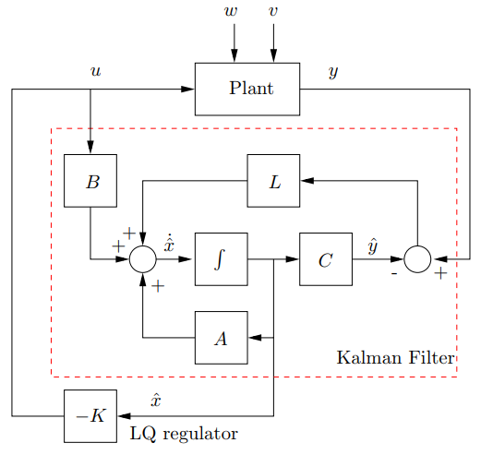
4. Linear Quadratic Gaussian Controller
LQG is the optimal controller obtained as the combination of
An optimal LQR state feedback gain
An optimal LQE state estimator.
Notes:
Elderly or patient with walking impairment

Slide 11


5. Example
We design an LQG controller to a spring-mass system
where covariance of , are I and 0.1 respectively
We use the parameter
MATLAB codes
n = 2; A = [0 1;-1 0];B = [0 1]';C = [1 0];
Q=5*C'*C; R = 1;
K = lqr(A,B,Q,R);
W = eye(n); V = 0.1;
L = lqe(A,eye(n),C,W,V);
Notes:
Elderly or patient with walking impairment

Slide 12
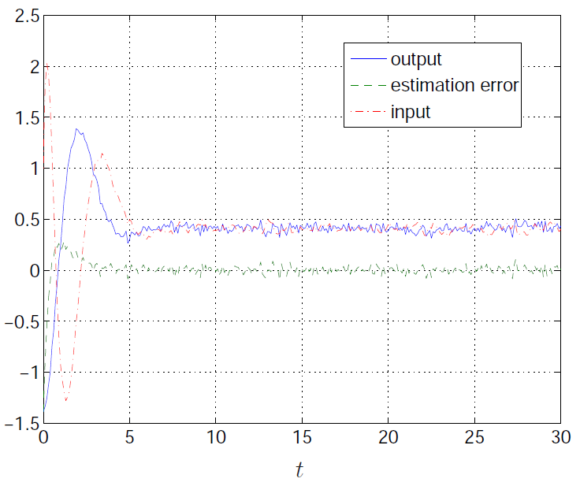
5. Example
Closed-loop response to unit step:
Notes:
Elderly or patient with walking impairment

Slide 13
Thank you!!
Notes:
Elderly or patient with walking impairment

